Slide 1
Building Android apps – Week 8a
2843-201710_MCS4993_M:Topics in MA/CS
2843-201710_MCS5993_M:Topics in Computer Science
Notes:
Look at the

Slide 2
Agenda
Chapter 12 HFAD – Connecting to databases
Chapter 13 HFAD – Services
Notes:
Think about what your app has to do when it opens a database. It first needs to go searching through the flash to find the database file. If the database file isn’t there, it needs to go create a blank database. Then it needs to run all of the SQL commands to create tables inside the database and any initial data it needs. Finally, it needs to fire off some queries to get the data out of there.That takes time. For a tiny database like the one used in the Starbuzz app, it’s not a lot of time. But as a database gets bigger and bigger, that time will increase and increase. Before you know it, your app will lose its mojo and will be slower than YouTube on Thanksgiving.

Slide 3
Chapter 12 – Async Threads
Main event
Render
All other threads
Notes:
The main event thread
This is the real workhorse in Android. It listens for intents, it receives touch messages from the screen, and it calls all of the methods inside your activities.
The render thread
You don’t normally interact with this thread, but it reads a list of requests for screen updates and then calls the low-level graphics hardware to repaint the screen and make your app look pretty.
All of the other thread that you create
If you’re not careful, your app will do almost all of its work on the main event thread. Why? Because it’s the main event thread that runs your event methods. If you just drop your database code into the onCreate() method (as we did in the Starbuzz app) then the main event thread will be busy talking to the database, instead of rushing off to look for any events from the screen or other apps. If your database code takes a long time, users will feel like they’re being ignored.
move your database code off the main event thread and run it in a custom thread in the background.

Slide 4
Notes:
When you use databases in your app, it’s a good idea to run database code in a background thread, and update views with the database data in the main event thread. We’re going to work through the onFavoritesClicked() method in the DrinkActivity code so that you can see how to approach this sort of problem.
1. Code that needs to be run before the database code
The first few lines of code gets the value of the favorite checkbox, and puts it in the drinkValues ContentValues object. This code must be run before the database code.
2. Database code that needs to be run on a background thread
This updates the DRINK table.
3. Code that needs to be run after the database code
If the database is unavailable, we want to display a message to the user. This must run on the main event thread.
We’re going to implement the code using an AsyncTask.

Slide 5
Notes:
The AsyncTask class lets you perform operations in the background. When they’ve finished running, it then allows you to update views in the main event thread. If the task is repetitive, you can even use it to publish the progress of the task while it’s running.
You create an AsyncTask by extending the AsyncTask class, and implementing its doInBackground() method. The code in this method runs in a background thread, so it’s the perfect place for you to put database code. The AsyncTask class also has an onPreExecute() method that runs beforedoInBackground(), and an onPostExecute() method that runs afterward. There’s an onProgressUpdate() method if you need to publish task progress.

Slide 6
private class MyAsyncTask extends AsyncTask<Params, Progress, Result>
protected void onPreExecute() {
//Code to run before executing the task
}
protected Result doInBackground(Params... params) {
//Code that you want to run in a background thread
}
protected void onProgressUpdate(Progress... values) {
//Code that you want to run to publish the progress of your task
}
protected void onPostExecute(Result result) {
//Code that you want to run when the task is complete
}
}
Notes:
AsyncTask is defined by three generic parameters: Params, Progress, and Results. Params is the type of object used to pass any task parameters to thedoInBackground() method, Progress is the type of object used to indicate task progress, and Result is the type of the task result. You can set any of these to Void if you’re not going to use them.
We’ll go through this over the next few pages by creating a new AsyncTask called UpdateDrinkTask we can use to update drinks in the background. Later on, we’ll add this to our DrinkActivity code.

Slide 7
Notes:
The onPreExecute() method
We’ll start with the onPreExecute() method. This gets called before the background task begins, and it’s used to set up the task. It’s called on the main event thread, so it has access to views in the user interface. The onPreExecute() method takes no parameters, and has a void return type.
We’re going to use the onPreExecute() method to get the value of the favorite checkbox, and put it in the drinkValues ContentValues object. This is because we need access to the checkbox in order to do this, and it must be done before any of our database code can be run. We’re using a separate attribute outside the method for the drinkValues ContentValues object so that other methods in the class can access it.

Slide 8
Notes:
The doInBackground() method runs in the background immediately after onPreExecute(). You define what type of parameters the task should receive, and what the return type should be.
We’re going to use the doInBackground() method for our database code so that it runs in a background thread. We’ll pass it the ID of the drink we need to update, and we’ll use a Boolean return value, so we can tell whether the code ran successfully:

Slide 9
Notes:
The onProgressUpdate() method
The onProgressUpdate() method is called on the main event thread, so has access to views in the user interface. You can use this method to display progress to the user by updating views on the screen. You define what type of parameters the method should have.
The onProgressUpdate() method runs if a call to publishProgress() is made by the doInBackground() method like this:

Slide 10
Notes:
In our example we’re not publishing the progress of our task, so we don’t need to implement this method. We’ll indicate that we’re not using any objects for task progress by changing the signature of UpdateDrinkTask:

Slide 11
Notes:
The onPostExecute() method
The onPreExecute() method is called after the background task has finished. It’s called on the main event thread, so has access to views in the user interface. You can use this method to present the results of the task to the user. The onPostExecute() method gets passed the results of the doInBackground()method, so must take parameters that match the doInBackground() return type.
We’re going to use the onPostExecute() method to check whether the database code in the doInBackground() method ran successfully. If it didn’t, we’ll display a message to the user. We’re doing this in the onPostExecute() method as this method can update the user interface; the doInBackground() method runs in a background thread, so can’t update views.

Slide 12
Notes:
The AsyncTask class
When we first introduced the AsyncTask class, we said it was defined by three generic parameters: Params, Progress, and Results. You specify what these are by looking at the type of parameters used by your doInBackground(), onProgressUpdate(), and onPostExecute() methods. Params is the type of the doInBackground() parameters, Progress is the type of the onProgressUpdate() parameters, and Result is the type of theonPostExecute() method:

Slide 13
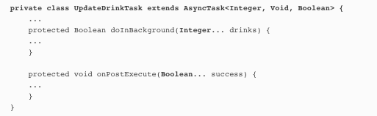
Notes:
In our example, doInBackground() takes Integer parameters, and onPostExecute() takes a Boolean parameter. We’re not using theonProgressUpdate() method. This means that in our example, Params is Integer, Progress is Void and Result is Boolean:

Slide 14
int drinkNo = (Integer)getIntent().getExtras().get(EXTRA_DRINKNO);
new UpdateDrinkTask().execute(drinkNo);
protected Boolean doInBackground(Integer... drinks) {
...
}
Notes:
Execute the AsyncTask
You run the task by calling your AsyncTask’s execute() method. If your doInBackground() method takes parameters, you add these to the execute()method. As an example, we want to pass the drink the user chose to the AsyncTask’s doInBackground() method, so we call it using:
The type of parameter you pass with the execute() method must match the type of parameter expected by the AsyncTask doInBackground() method. OurdoInBackground() method takes Integer parameters, so we need to pass integers:

Slide 15
Notes:
We’re going to execute UpdateDrinkTask in DrinkActivity’s onFavoritesClicked() method. Here’s what the method looks like:

Slide 16
Notes:
The DrinkActivity.java code
When you create an AsyncTask, you add it as an inner class to the activity that needs to use it. We’re going to add our UpdateDrinkTask class as an inner class to DrinkActivity.java.
We’ll execute the task in DrinkActivity’s onFavoriteClicked() method so that the task updates the database in the background when the user clicks on the favorite checkbox.

Slide 17
Notes:
That’s everything you need in order to create an AsyncTask. When the user clicks on the favorite checkbox in DrinkActivity, the database gets updated in the background.

Slide 18
Notes:
onPreExecute() is used to set up the task.
It’s called before the background task begins, and runs on the main event thread.
doInBackground() runs in the background thread.
It runs immediately after onPreExecute(). You can specify what type of parameters it has, and what its return type is.
onProgressUpdate() is used to display progress.
It runs in the main event thread when the doInBackground() method calls publishProgress().
onPostExecute() is used to display the task outcome to the user when doInBackground has finsihed.
It runs in the main event thread. It takes the return value of doInBackground() as a parameter.
There are some operations you want to keep on running, irrespective of which app has the focus.
As an example, If you start playing a music file in a music app, you’d probably expect it to keep on playing when you switch to another app. In this chapter, you’ll see how to use services to deal with situations just like this. Along the way, you’ll see how to use some of Android’s built-in services. You’ll see how to to keep your users informed with the notification service, and how the location service can tell you where you’re located.

Slide 19
Chapter 13 – Services
Standard Services
Bound Services
Notes:
Services work behind the scenes
An Android app is a collection of activities and other components. The bulk of your code is there to interact with the user, but sometimes you need to do things in the background. You might want to download a large file, stream a piece of music, or listen for a message from the server.
These kinds of tasks aren’t what activities are designed to do. In simple cases, you can create a thread, but if you’re not careful your activity code will start to get complex and unreadable.
That’s why services were invented. A service is an application component like an activity but without a user interface. They have a simpler lifecycle than an activity, and they come with a bunch of features that make it easy to write code that will run in the background while the user is doing something else.
THERE ARE TWO TYPES OF SERVICE
Services come in two different flavors:
Started services
A started service can run in the background indefinitely, even when the activity that started it is destroyed. If you wanted to download a large file from the Internet, you would probably create it as a started service. Once the operation is done, the service stops.
Bound services
A bound service is bound to another component such as an activity. The activity can interact with it, send requests, and get results. A bound service runs as long as components are bound to it. When components are no longer bound to it, the service is destroyed. If you wanted to create an odometer to measure the distance traveled by a vehicle, you’d probably use a bound service. This way, any activities bound to the service could keep asking the service for updates on the distance traveled.

Slide 20
Bullet Points
A service is a component that can perform tasks in the background. It doesn’t have a user interface.
A started service can run in the background indefinitely, even when the activity that started it is destroyed. Once the operation is done, it stops itself.
You declare services in AndroidManifest.xml using the <service> element.
You can create a simple started service by extending the IntentService class and overriding its onHandleIntent() method. The IntentServiceclass is designed for handling intents.
You start a started service using the startService() method.
If you override the IntentService onStartCommand() method, you must call its super implementation.
You create a notification using a notification builder. You get your notification to start an activity using a pending intent. You then use Android’s notification service to display the notification.
A bound service is bound to another component such as an activity. The activity can interact with it and get results.

Slide 21
Bullet Points
You usually create a bound service by extending the Service class. You must define your own Binder object, and override the onBind() method. This is called when a component wants to bind to the service.
The Service onCreate() method is called when the service is created. Use it for instantiation.
The Service onDestroy() method is called when the service is about to be destroyed.
You can use the Android location service to get the current location of the device. You create a LocationListener, and then register it with the location service. You can add criteria for how often the listener is notified of changes. When you use the device GPS, you need to add a permission for it inAndroidManifest.xml.
To bind an activity to a service, you create a ServiceConnection. You override the onServiceConnected() method to get a reference to the service.
You bind to the service using the bindService() method. You unbind from the service using the unbindService() method.

Slide 22
Notes:
we’re going to create two services: a started service and a bound service. We’ll start with the started service.
The started service app
We’re going to create a new project that contains an activity called MainActivity, and a service called DelayedMessageService. WheneverMainActivity calls DelayedMessageService, it will wait for 10 seconds and then display a piece of text.

Slide 23
Standard Service
Display the message in the log
Display the message in a Toast
Display message in a Notification
Notes:
We’re going to do this in three stages:
Display the message in the log.
We’ll start by displaying the message in the log so that we can check the service works OK. We can look at the log in Android Studio.
Display the message in a Toast.
We’ll get the message to appear in a pop-up toast so that you don’t have to keep your device connected to Android Studio in order to see it working.
Display the message in a Notification.
We’ll get DelayedMessageService to use Android’s built-in notification service to display the message in a notification. This will mean that the user will be able to look at the message at a later time.

Slide 24
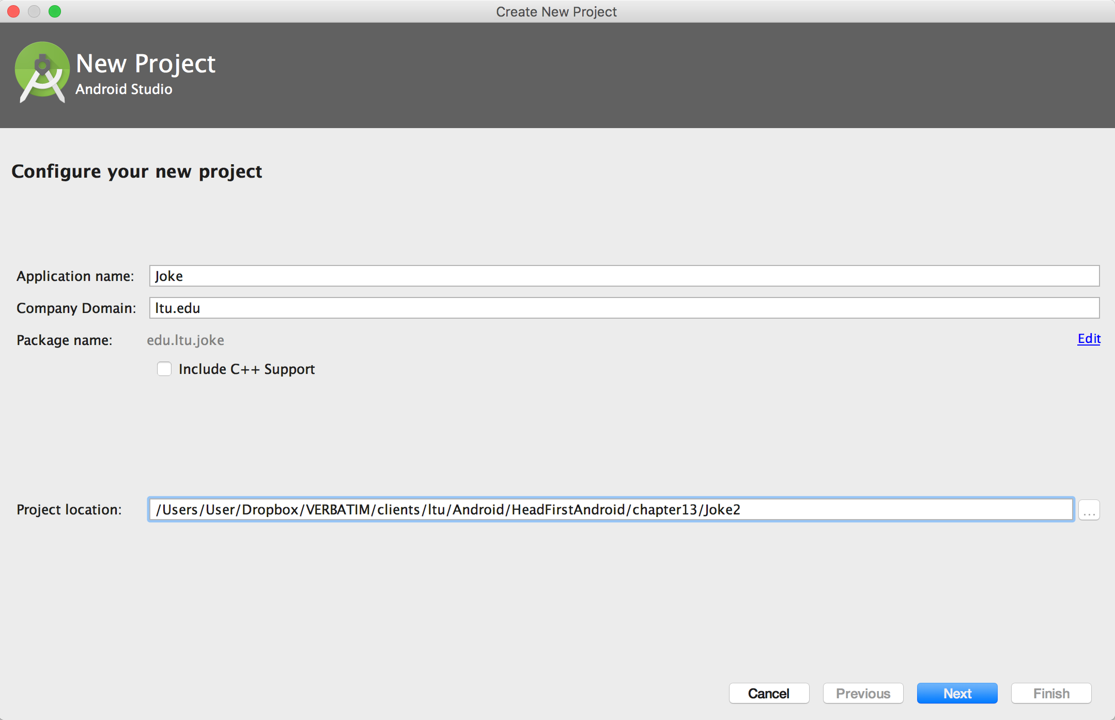
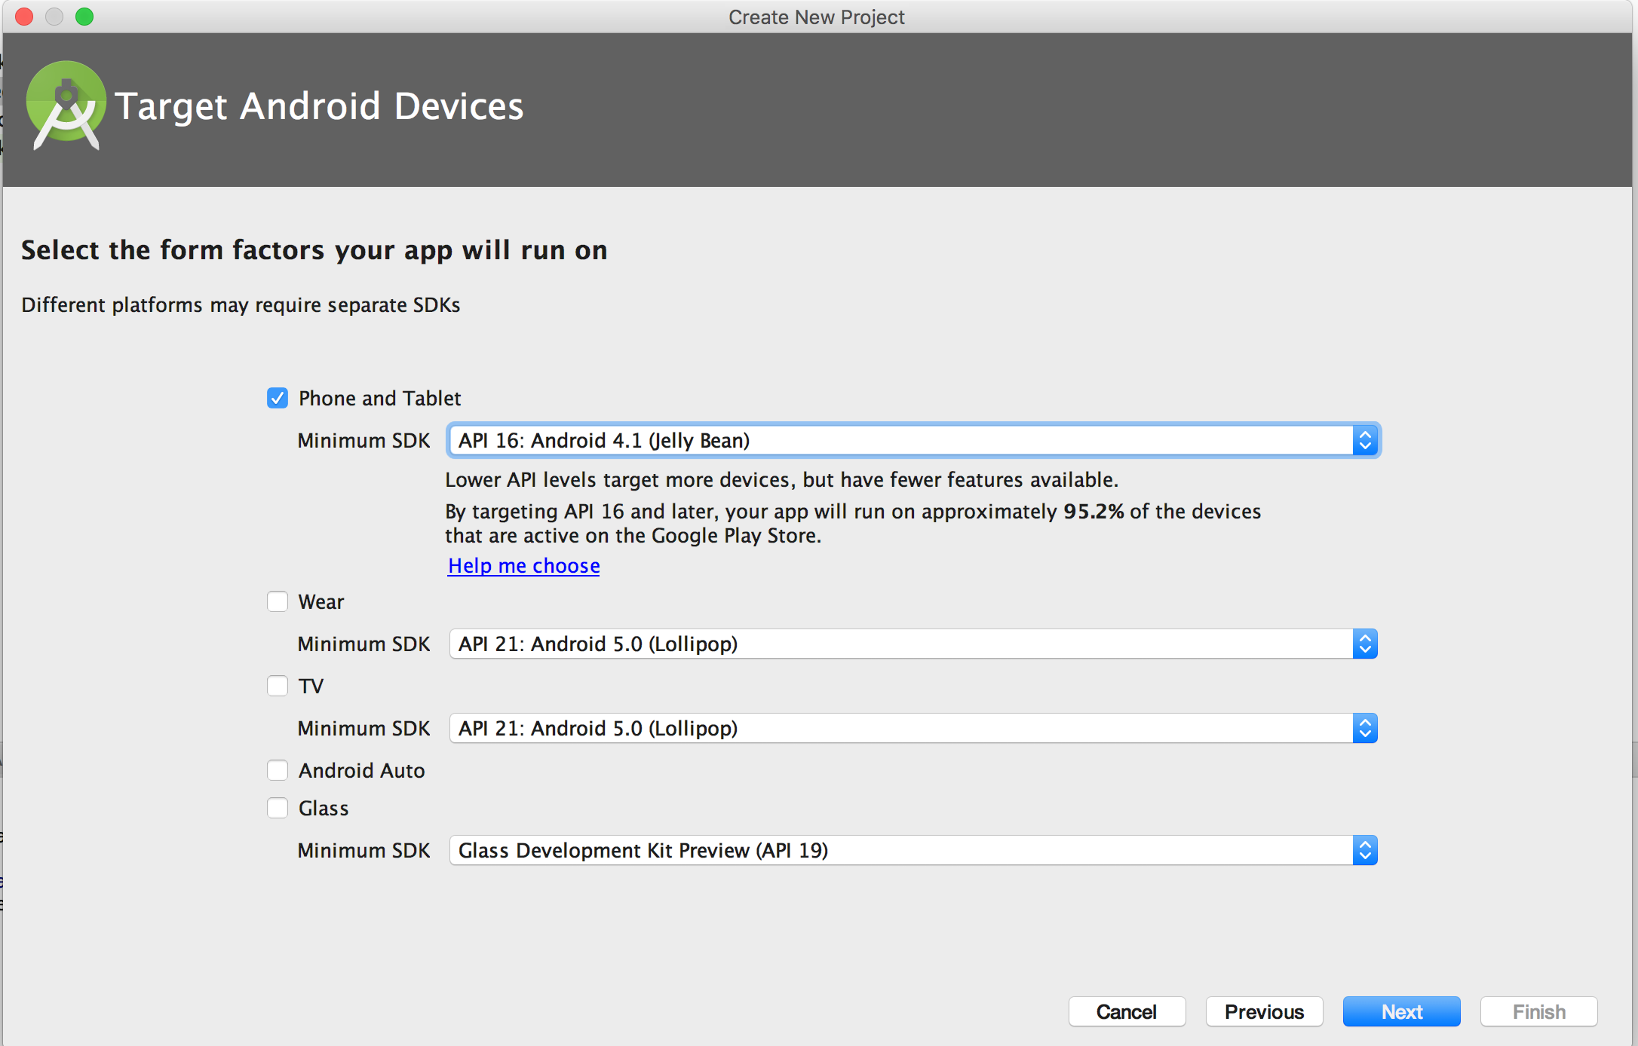
Notes:
CREATE THE PROJECT
We’ll start by creating the project. Create a new Android project for an application named “Joke” with a package name of com.hfad.joke. The minimum SDK should be API 16 so that it will work with most devices. You’ll need a blank activity called “MainActivity” and a layout called “activity_main” so that your code matches ours.
The next thing we need to do is create the service.

Slide 25
Notes:
You create a new service by extending either the Service class or the IntentService class. The Service class is the base class for creating services. It provides you with basic service functionality, and you’ll usually extend this class if you want to create a bound service.

Slide 26
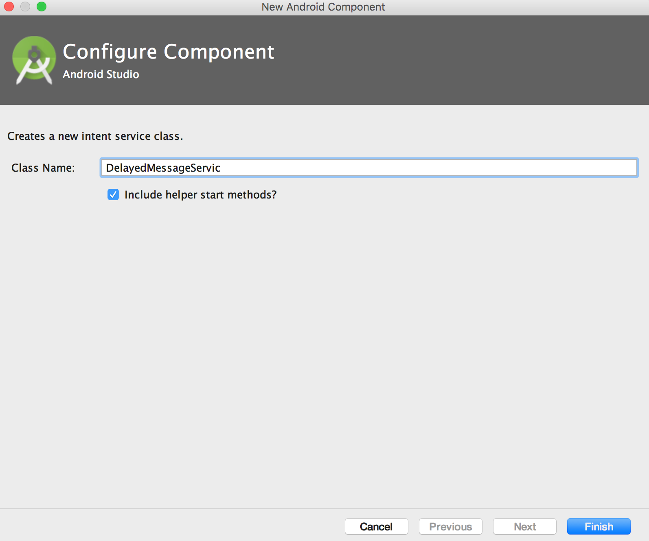
Notes:
The IntentService class is a subclass of Service that’s designed to handle intents.
we’re going to add a new intent service to the project. To do this, go to File→New... and select the Service option. When prompted, choose the option to create a new IntentService. Give the service a name of DelayedMessageService, and untick the option to include helper start method. This is because we’re going to replace the code that Android Studio generates for us.

Slide 27
Notes:
You implement an intent service by extending the IntentService class and implementing its onHandleIntent() method.
This method should contain the code you want to run when the service is called:

Slide 28
Notes:
An activity says what service it needs to call by creating an explicit intent.
The intent specifies the service it’s intended for.
The intent is passed to the service.
The service starts and handles the intent.
The IntentService onHandleIntent() method gets called and runs in a separate thread. If the service is passed multiple intents, it deals with them in sequence, one at a time. Once the service has finished running, it stops.
As you can see, a service is started in the same way that you start an activity: by creating an intent. The difference is that when you start a service, what’s on screen doesn’t change because the service has no user interface.
We want DelayedMessageService to display a message in Android’s log. Before we update the service, let’s look at how you log messages.

Slide 29
Log Type | Description
Log.v(String tag, String message) | Logs a verbose message.
Log.d(String tag, String message) | Logs a debug message.
Log.i(String tag, String message) | Logs an information message.
Log.w(String tag, String message) | Logs a warning message.
Log.e(String tag, String message) | Logs an error message.
Log.v("DelayedMessageService", "This is a message");
Notes:
Adding messages to a log can be a useful way of checking your code is working the way you want. You tell Android what to log in your Java code, and when the app’s running, you check the output in Android’s log, or logcat.
You log messages using one of the following methods in the Android.util.Log class:

Slide 30
Notes:
You can view the logcat in Android Studio, and filter by the different types of message.
To see the logcat, select the Android option at the bottom of your project screen in Android Studio and then select the Devices|logcat tab:
SHOW

Slide 31
Notes:
The full DelayedMessageService code
We want our service to get a piece of text from an intent, wait for 10 seconds, then display the piece of text in the log.
To do this, we’ll create a showText() method to log the text, and then call it from the onHandleIntent() method after a delay.
Here’s the full code for DelayedMessageService.java

Slide 32
Notes:
Just like activities, services need to be declared in AndroidManifest.xml using the <service> element. This is so that Android can call the service; if a service isn’t declared in AndroidManifest.xml, Android can’t call it.
Android Studio declares the service in AndroidManifest.xml for you automatically when you create a new service. Here’s what the code looks like:
The <service> element contains two attributes.
The android:name attribute tells Android what the name of the service is—in our case, DelayedMessageService.
The android:exported attribute tells Android whether the service can be used by other apps. Setting it to false means that the service will only be used within the current app.

Slide 33
Notes:
Now that we have a service, we need to run it by getting an activity to call it.
Add a button to activity_main.xml
We’re going to get MainActivity to start DelayedMessageService whenever a button is clicked.
We’ll start by adding the button to MainActivity’s layout.
First, add the following values to strings.xml:

Slide 34
Notes:
Next, update activity_main.xml so that MainActivity displays a button:

Slide 35
Notes:
You start a service from an activity in a similar way to how you start another activity.
You create an explicit intent that’s directed at the service you want to start. You then start the service using the startService() method:

Slide 36
Notes:
We’ll use this in MainActivity’s onClick() method so that the service gets started whenever its button gets clicked. Here’s the code:

Slide 38
Notes:
Press the button, switch back to Android Studio, and watch the logcat output in the lower-right corner of the IDE. After 10 seconds, the word “Timing!” appears in the logcat.
SHOW APP – Logging is enabled, will need to change it back for the toast and notification

Slide 39
Notes:
Services don’t have user interfaces like activities do, but that doesn’t mean that they don’t need to keep the user informed about stuff that’s happening. The user might need to know when a file has been downloaded, for instance.
In our case, it would be a lot neater if we could display a message in a toast on the screen instead of in the log. There’s just one thing—any code that updates the user interface needs to run in the main thread

Slide 40
Screen updates require the main thread
Create a handler in the main method
Use the Handler post() method in the service onHandleIntent() method to display
Notes:
when you use an intent service, you put the code you want to run in the onHandleIntent() method. This code then runs in the background in a separate thread. This is great for code that you want to run in the background, but not so great if you want to update the user interface. This is because you can only update the user interface in the main thread.
To get around this, we’ll use a handler. As we said back in Chapter 4, a handler lets you post code that needs to be run to a separate thread. We can use the handlerpost() method to post the code to create a toast to the main thread. The code will then run on the main thread and the toast will get displayed correctly.

Slide 41
Notes:
onStartCommand() runs on the main thread
To create a handler on the main thread, we need to create a Handler object in a method that runs on the main thread. We can’t use the onHandleIntent()method, as this runs in a background thread. Instead, we’ll use the onStartCommand() method.
The onStartCommand() method gets called every time the intent service is started. The onStartCommand() method runs on the main thread, and runs before the onHandleIntent() method. If we create a handler in the onStartCommand() method, we’ll be able to use it to post code to the main thread in theonHandleIntent() method:
When you use the onStartCommand(), you must call its super implementation using:
super.onStartCommand(intent, flags, startId)This is so that the intent service can properly handle the life of its background thread.

Slide 42
Notes:
Let’s take a closer look at the line of code that displays the toast:
Toast.makeText(getApplicationContext(), text, Toast.LENGTH_LONG).show();
The first parameter of the Toast.makeText() method is the context in which you want the toast to appear.
When you create a toast in an activity, you use this to pass it the instance of the current activity.
This doesn’t work in a service, because the service context doesn’t have access to the screen. Whenever you need a context in a service in situations like this, you must use getApplicationContext() instead. This gives us the context for whatever app happens to be in the foreground when the code is run. It means that the service will be able to make a toast appear, even if we’ve switched to a different app.

Slide 43
Notes:
SHOW

Slide 44
Bullet Points
A service is a component that can perform tasks in the background. It doesn’t have a user interface.
A started service can run in the background indefinitely, even when the activity that started it is destroyed. Once the operation is done, it stops itself.
You declare services in AndroidManifest.xml using the <service> element.
You can create a simple started service by extending the IntentService class and overriding its onHandleIntent() method. The IntentServiceclass is designed for handling intents.
You start a started service using the startService() method.
If you override the IntentService onStartCommand() method, you must call its super implementation.
You create a notification using a notification builder. You get your notification to start an activity using a pending intent. You then use Android’s notification service to display the notification.
A bound service is bound to another component such as an activity. The activity can interact with it and get results.

Slide 45
Bullet Points
You usually create a bound service by extending the Service class. You must define your own Binder object, and override the onBind() method. This is called when a component wants to bind to the service.
The Service onCreate() method is called when the service is created. Use it for instantiation.
The Service onDestroy() method is called when the service is about to be destroyed.
You can use the Android location service to get the current location of the device. You create a LocationListener, and then register it with the location service. You can add criteria for how often the listener is notified of changes. When you use the device GPS, you need to add a permission for it inAndroidManifest.xml.
To bind an activity to a service, you create a ServiceConnection. You override the onServiceConnected() method to get a reference to the service.
You bind to the service using the bindService() method. You unbind from the service using the unbindService() method.

Slide 46
Thursday
Chapter 13 - Services
Network access

